Slide 1
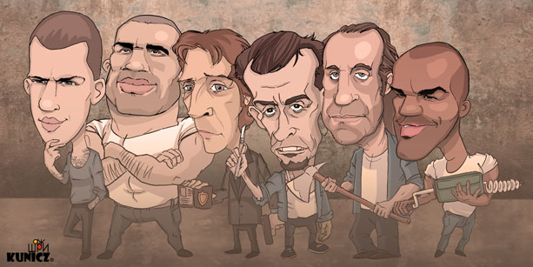
Azulianoscara
Brainstorm + Pitch

Slide 2
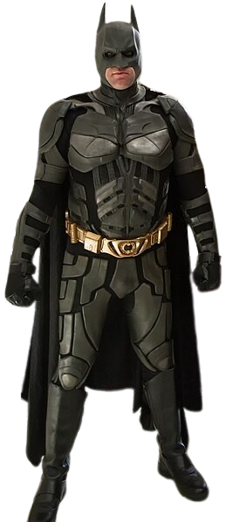

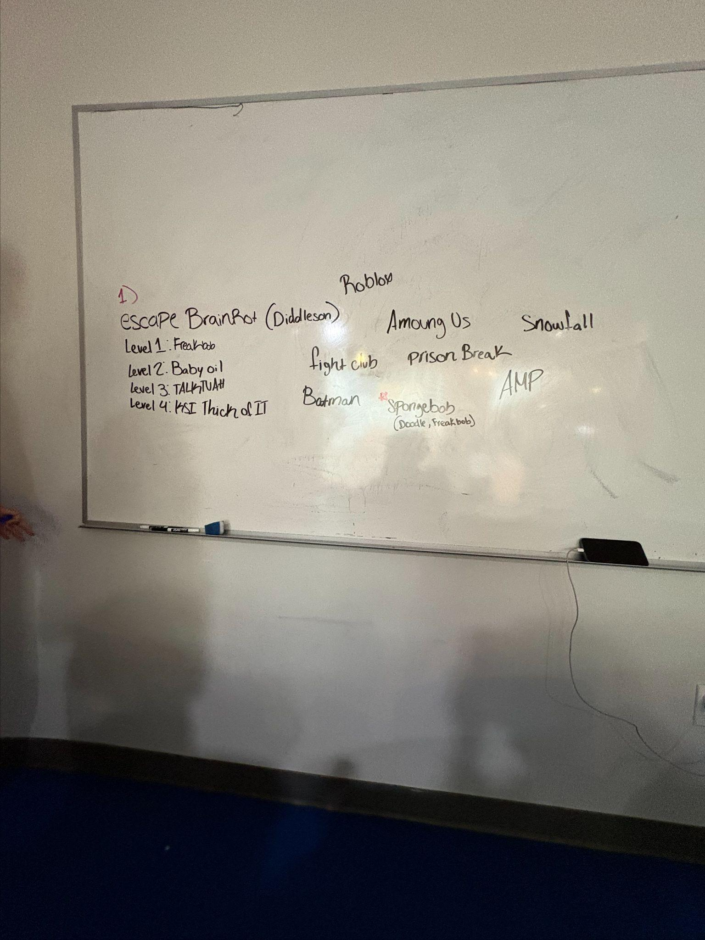


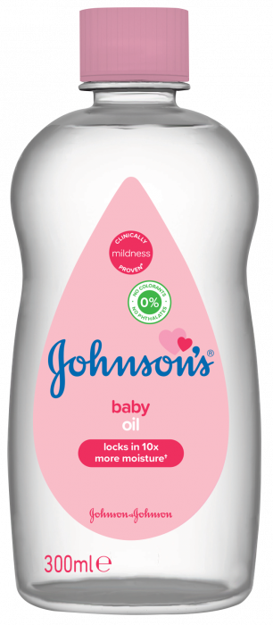
Ideas That Didn’t Make The Cut
Escape Brain Rot
Escape Spongebob
Fight Club escape
AMP escape
Batman escape
Roblox escape obby
Among us
Snowfall escape

Slide 3
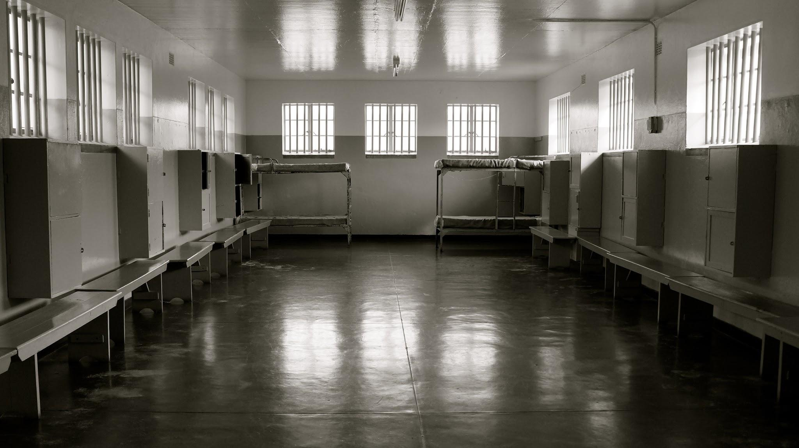
Chosen theme: Prison break
Narrative: You find yourself convicted of a crime you didn't commit and get sentenced to life in prison.Find hidden objects,crack codes and cut off lights to escape the prison and live a happy life.
Goal: Get your freedom and live a happy life

Slide 4

Prison break
(Intro) Azul Pinkman
(First room) Azul Pinkman
(Second room) Aniya Gillings Fring
(Third room) (Walter BB)-Julian white
(WW Easter egg)-Julian White
(Fourth room) Oscar Ortiz

Slide 5
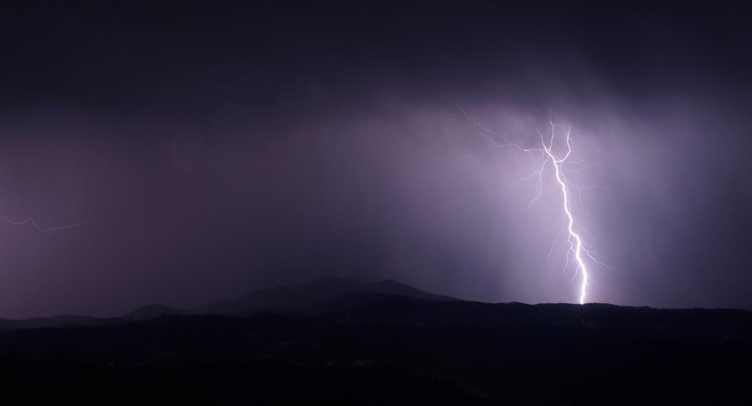
Room 1

Slide 6
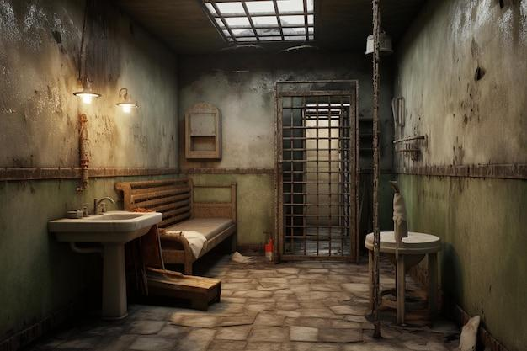

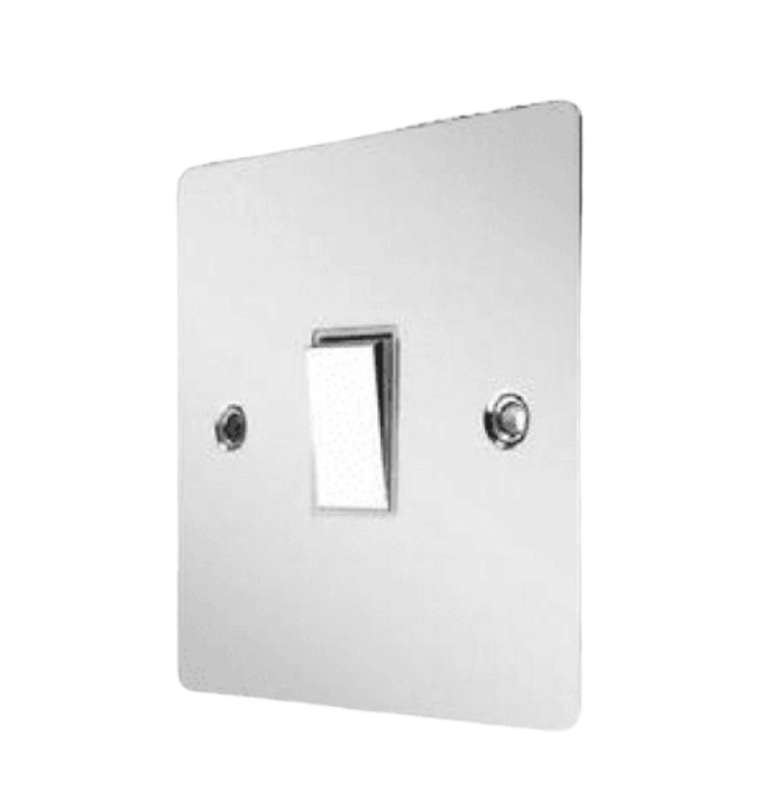

?

Slide 7

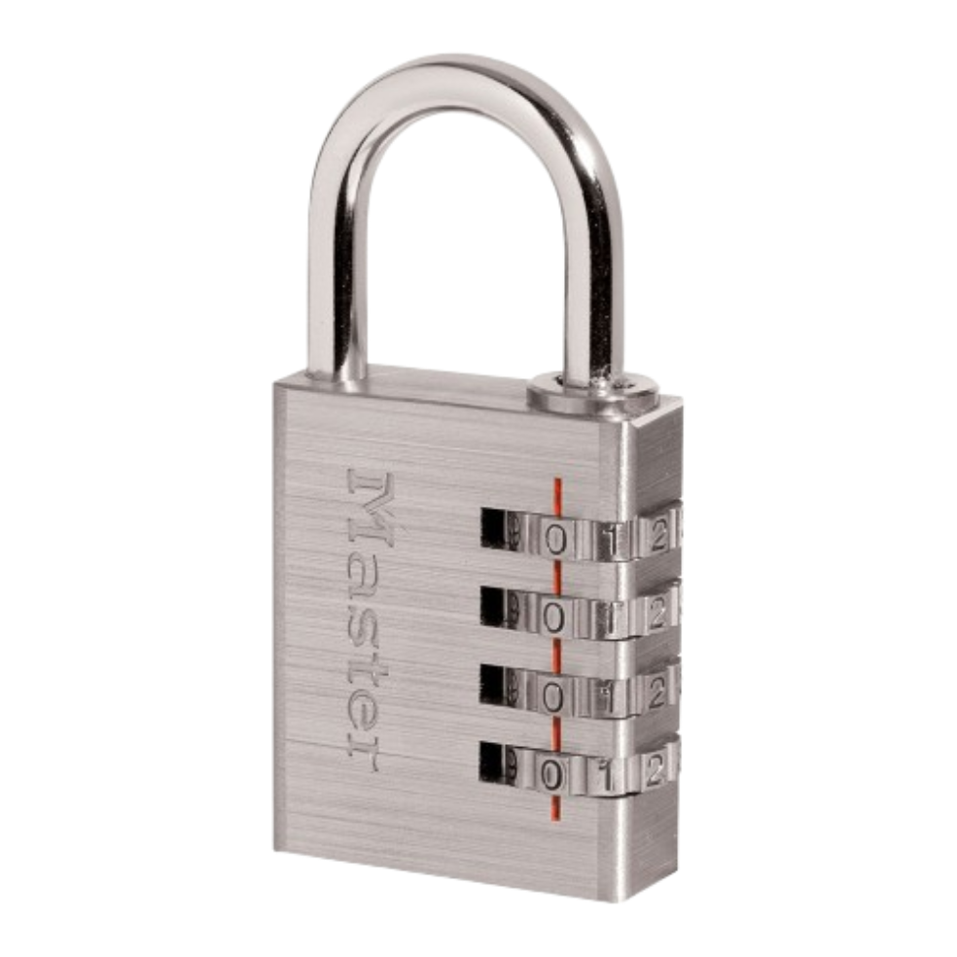
I know you're not the one who did it
-WW
65
?

Slide 8
I know you're not the one who did it
-WW
65
6 5

Slide 9
Number of clicks
?

Slide 10
I know you're not the one who did it
-WW
65
6
5

Slide 11
Enter here
?

Slide 12
?

Slide 13
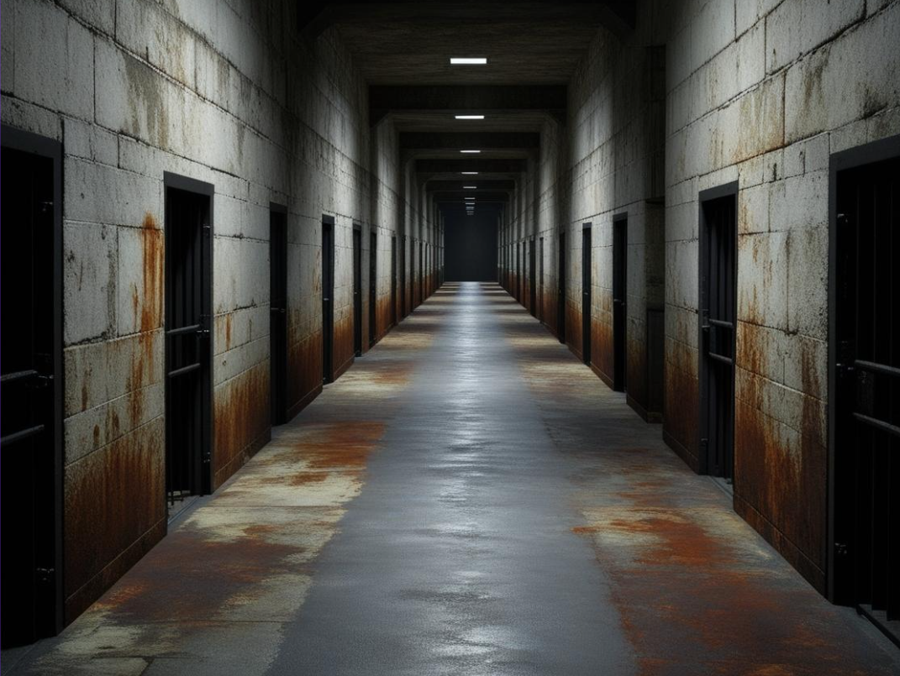
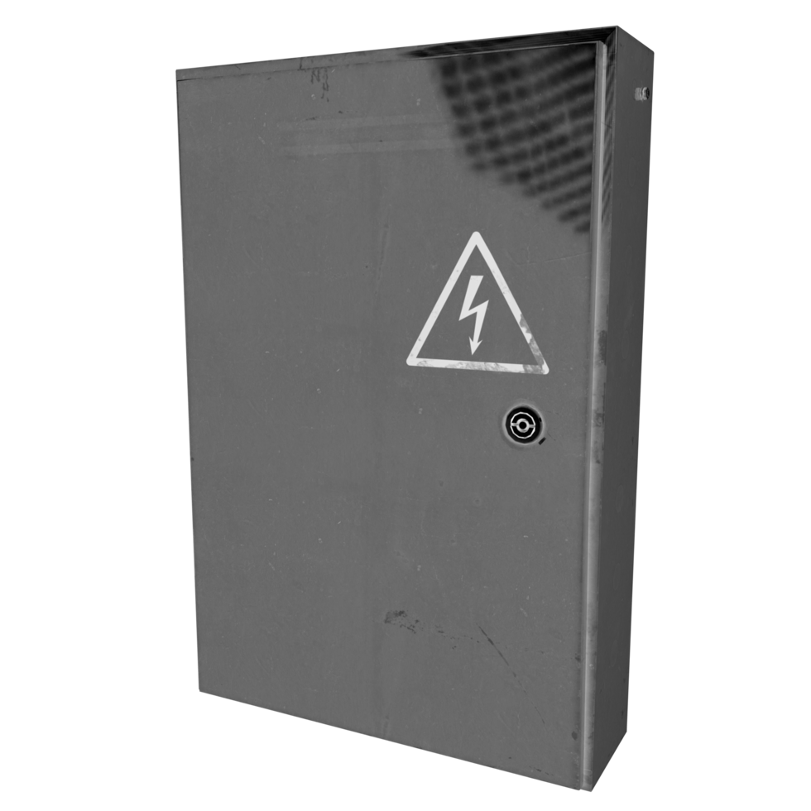

Slide 14
Room 2

Slide 15
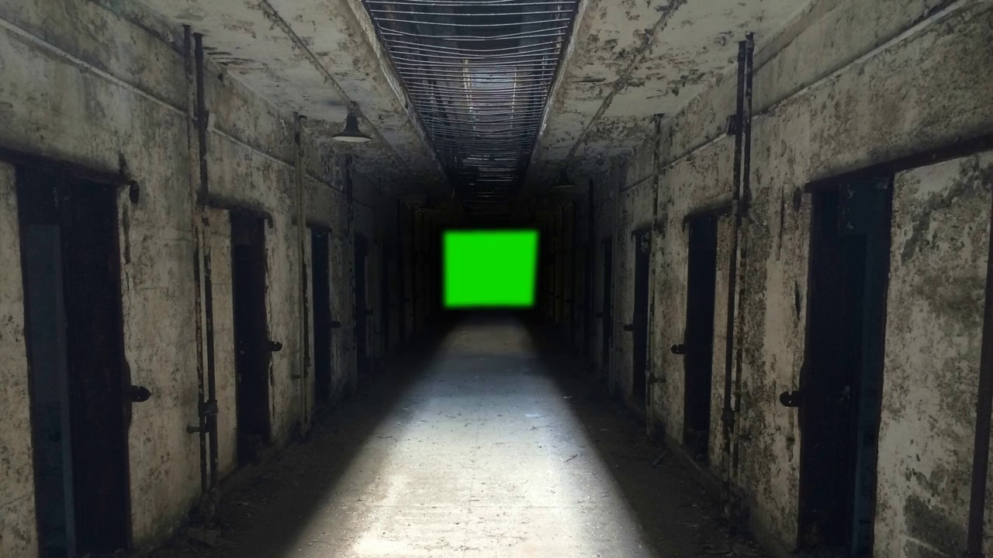
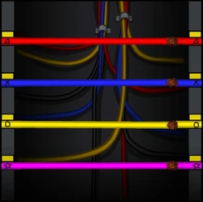
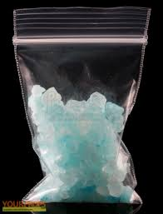
Aniya: Room 2
You escape the cell and you have to turn off the lights so you don’t get caught!
You have break the wires by changing the shapes but there’s a specific pattern that will be hidden
There’s gonna be hidden “rock candy” when you finish breaking the cords if the timer is still going
10 second
Timer before it resets

Slide 16

Aniya: Room 2
Turn off the lights so security cant see!

Slide 17
Aniya: Room 2
Turn off the lights so security cant see!

Slide 20



Cool things to add:
Cool cursor
Add cool sound
Fix that ugly picture
HURRY!! Turn off the lights before security catches you
Cut the cords to turn off the lights

Slide 22
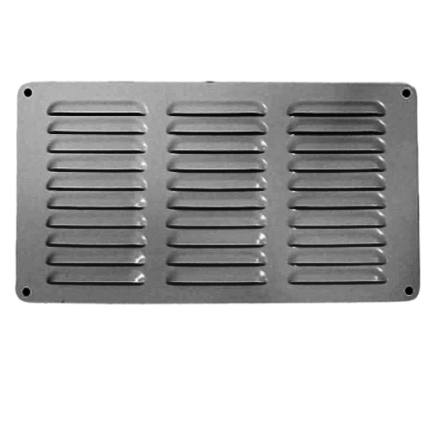
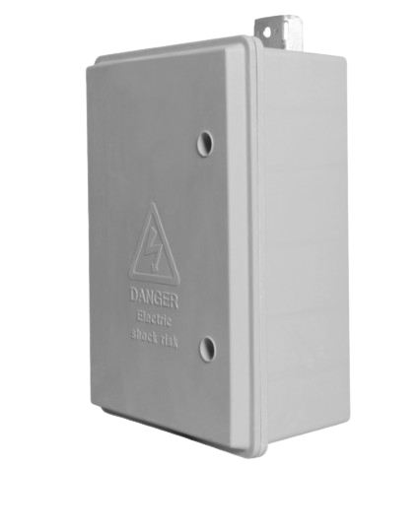
When you match it right, the screen goes black (light off) and there's a vent you see. When you click it takes you to the next room
Hint for next room

Slide 23
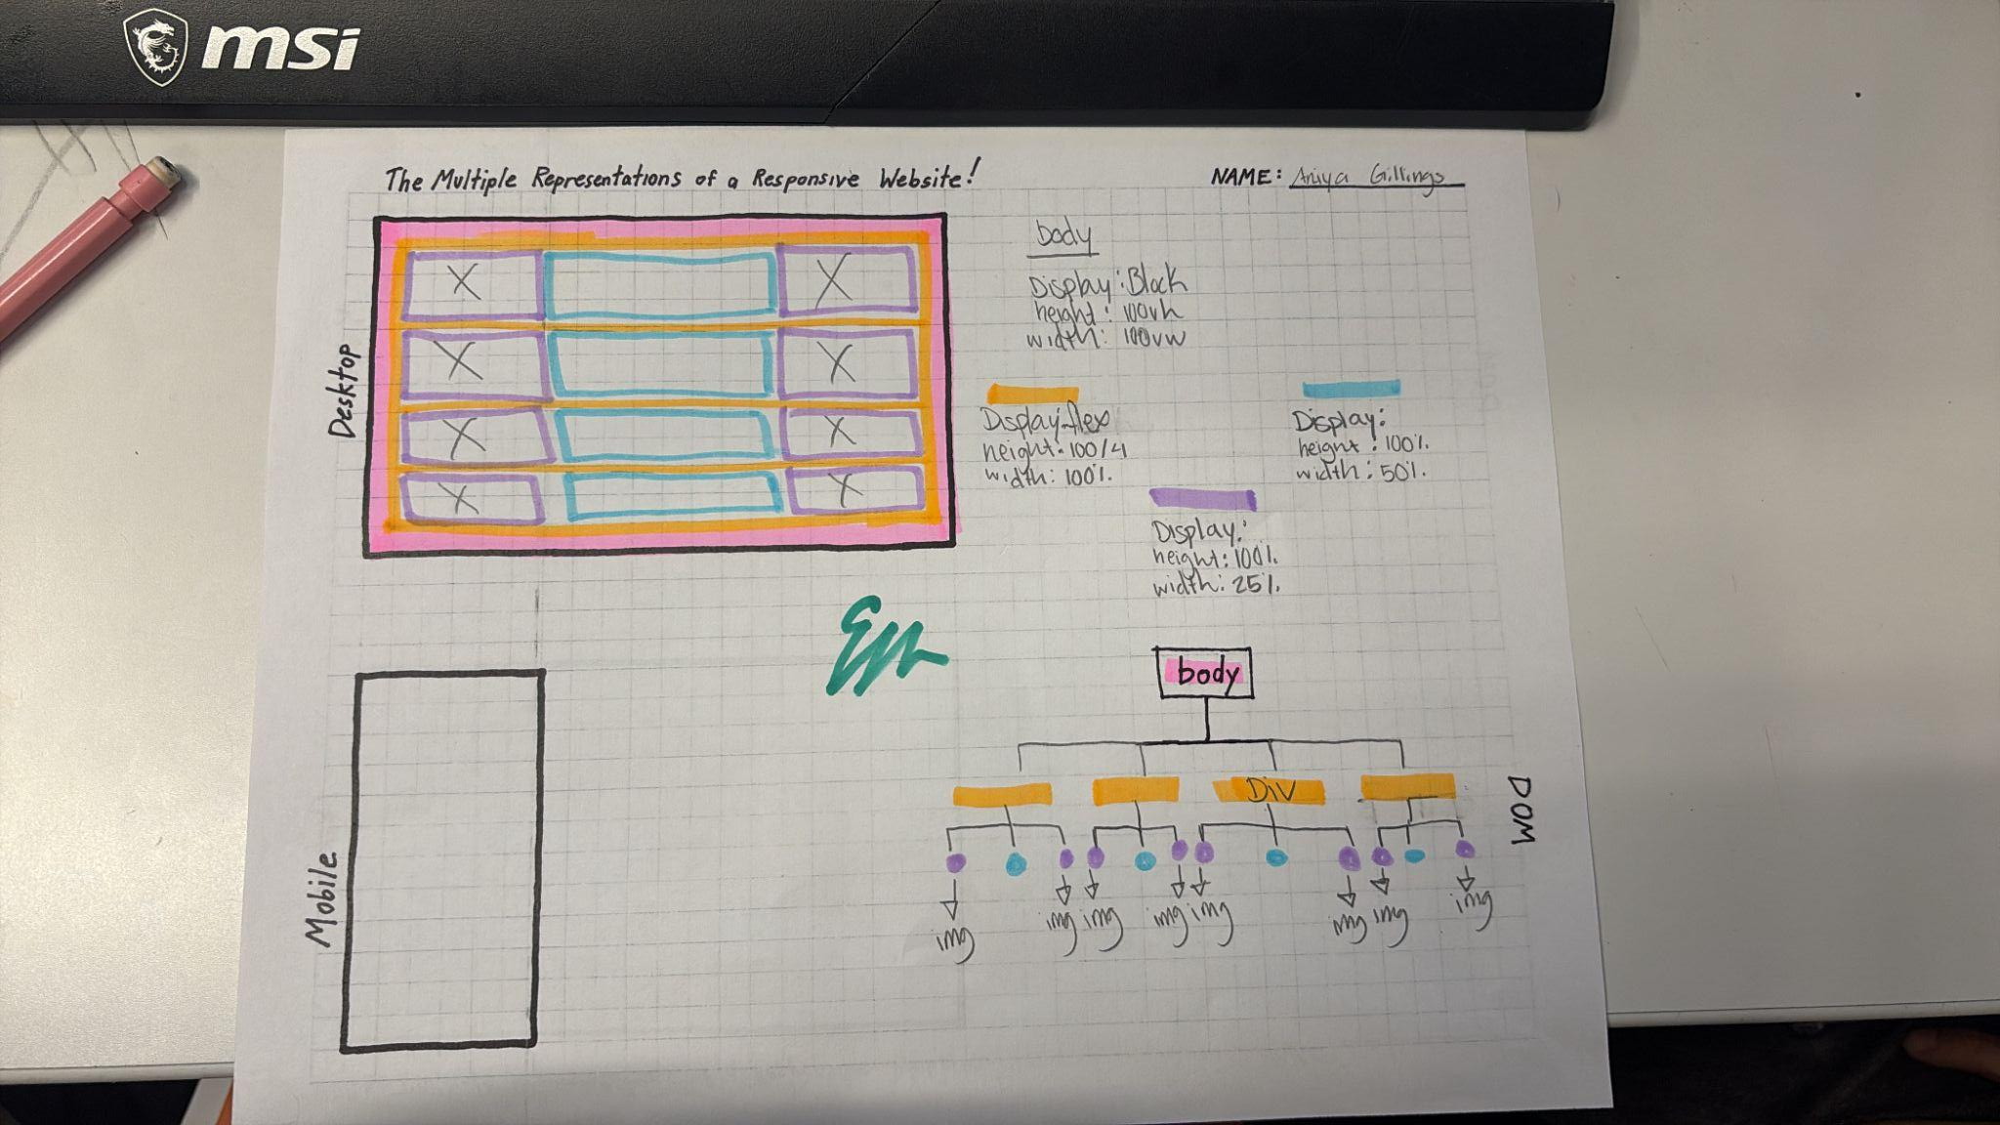

Slide 24
Room 3

Slide 25
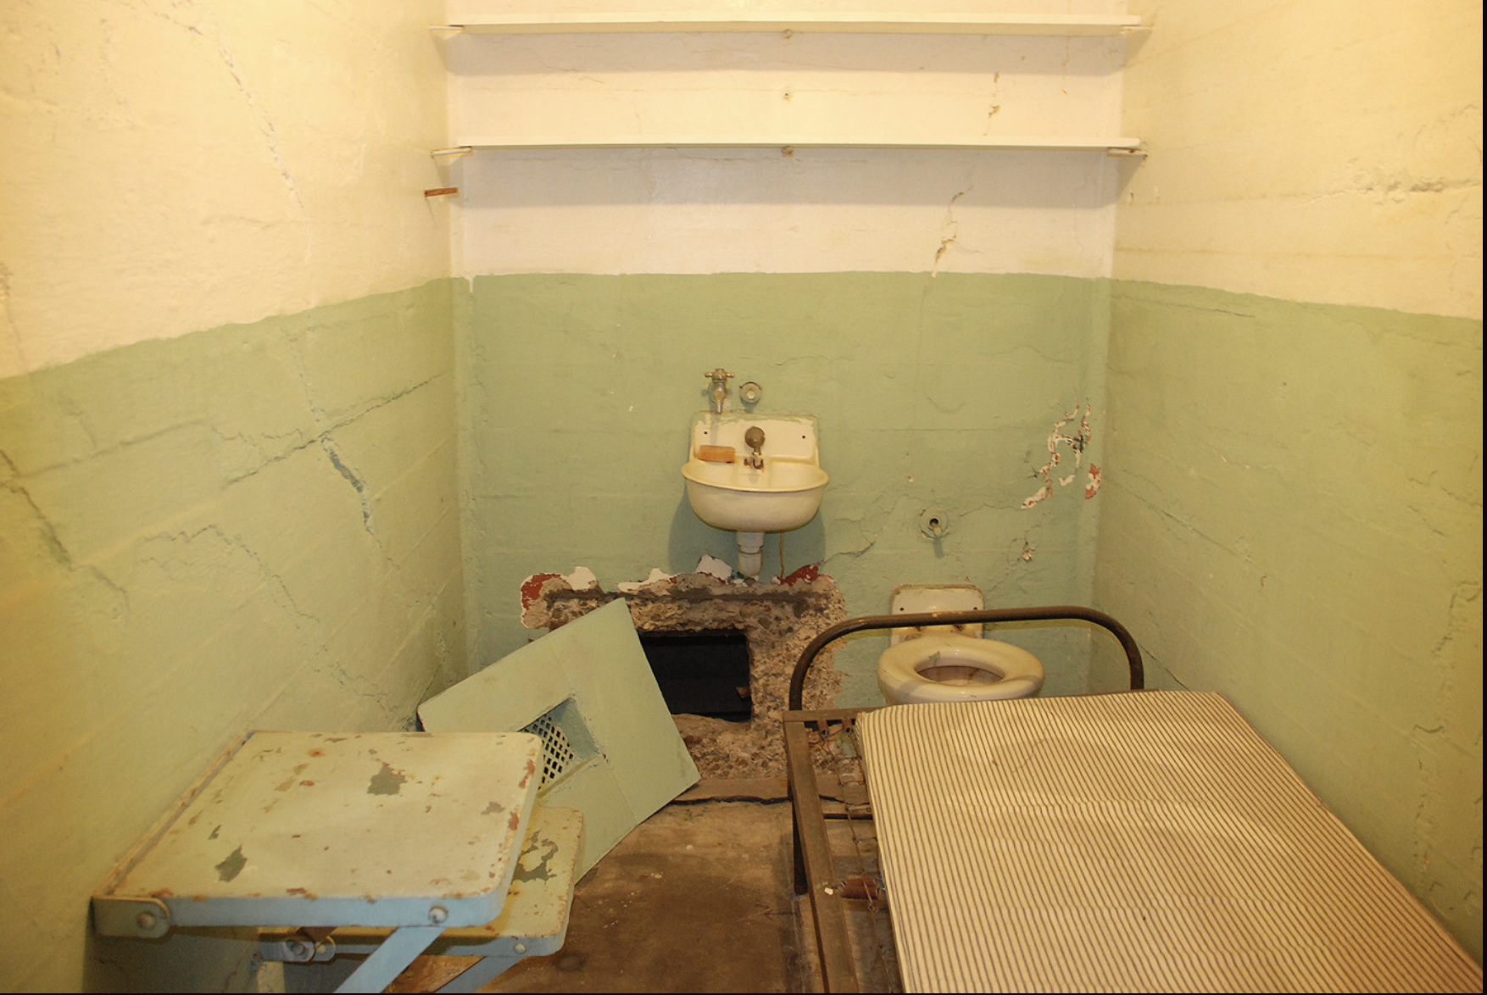
WW Easter Egg, if they click on “Rock Candy” they can get a hint to the next room

Slide 26

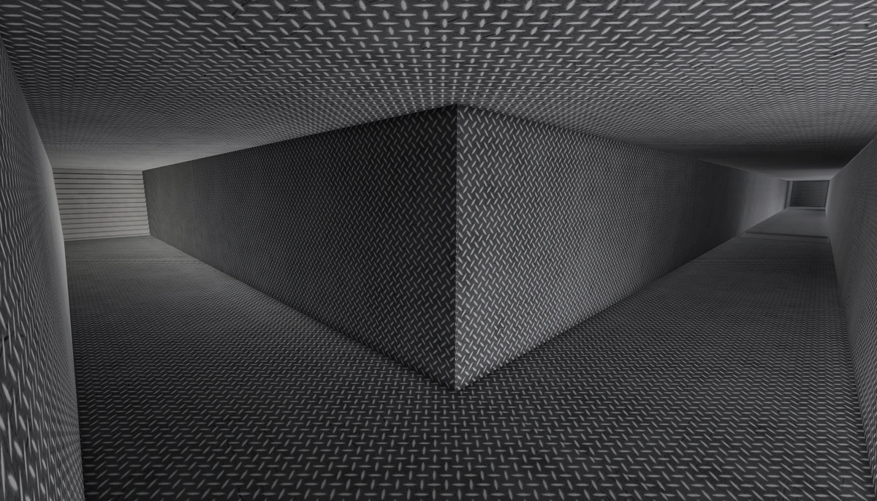

Q1 Fridays are usually good. Except in October, give me a date.
1
2
4
5
Q2 I asked a German man if he could give me the time, I could tell he didn't like foreigners. He responded with no. What number did he appear to say?
6
7
8
9
10
Q3 I am a single digit, but multiply me by two,
Then add three to me, and you’ll see it’s true.
What number am I?
11
12
13
14
15

Slide 27
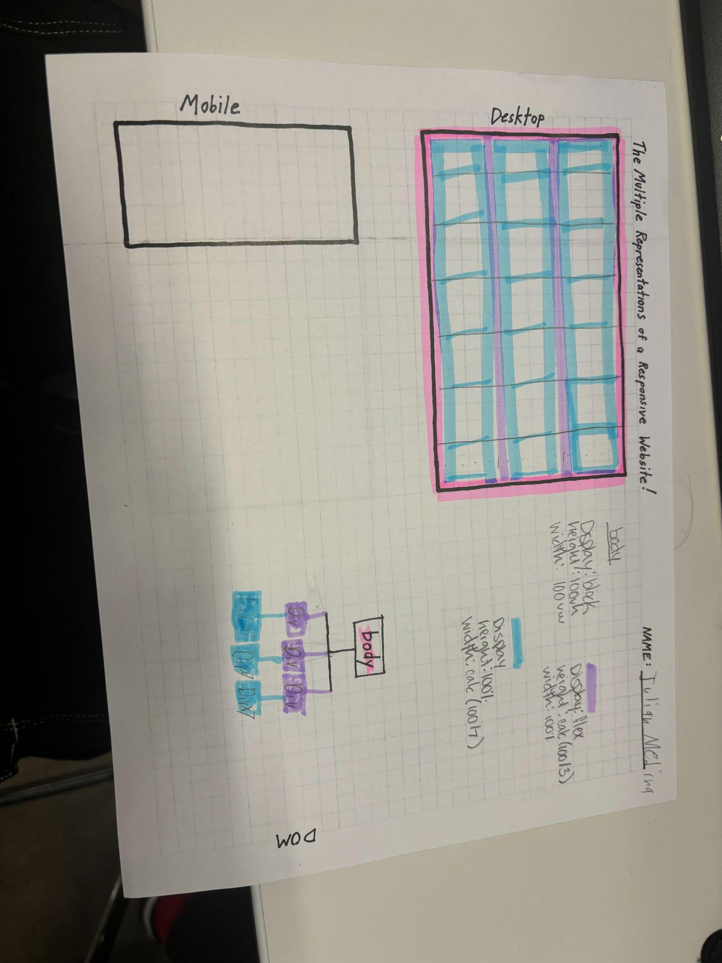
EM

Slide 28
Room 4

Slide 29
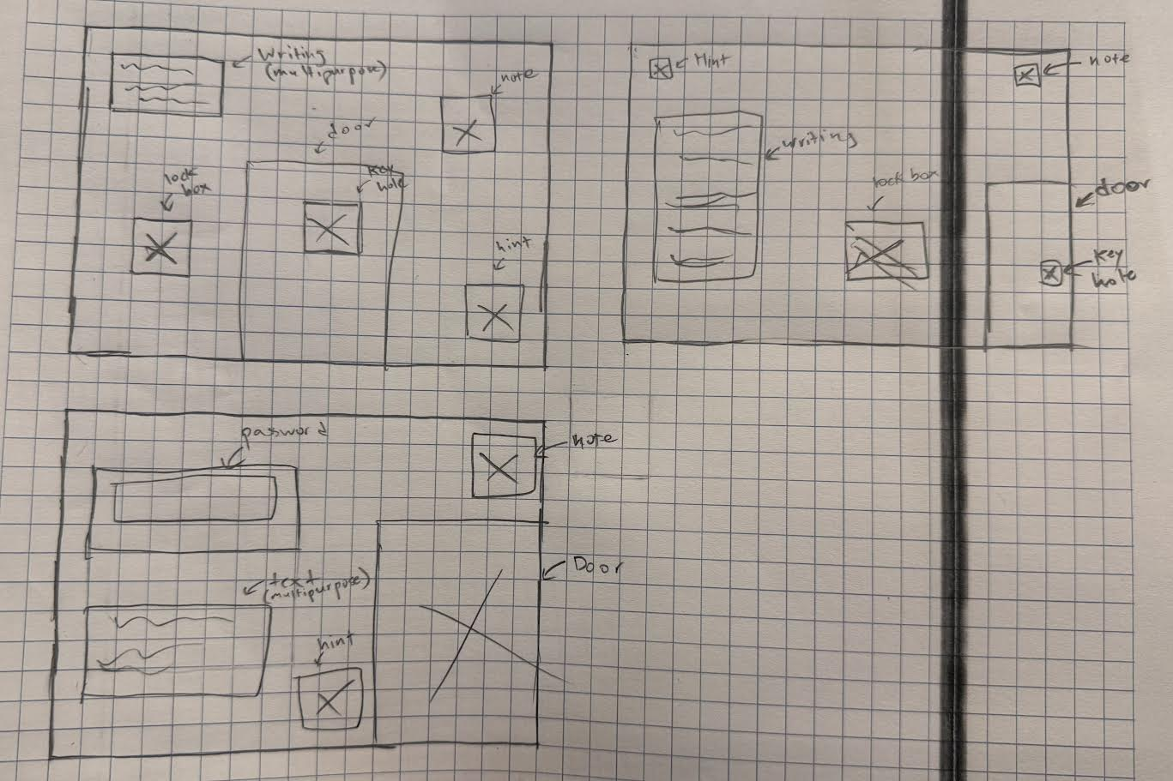

Slide 30
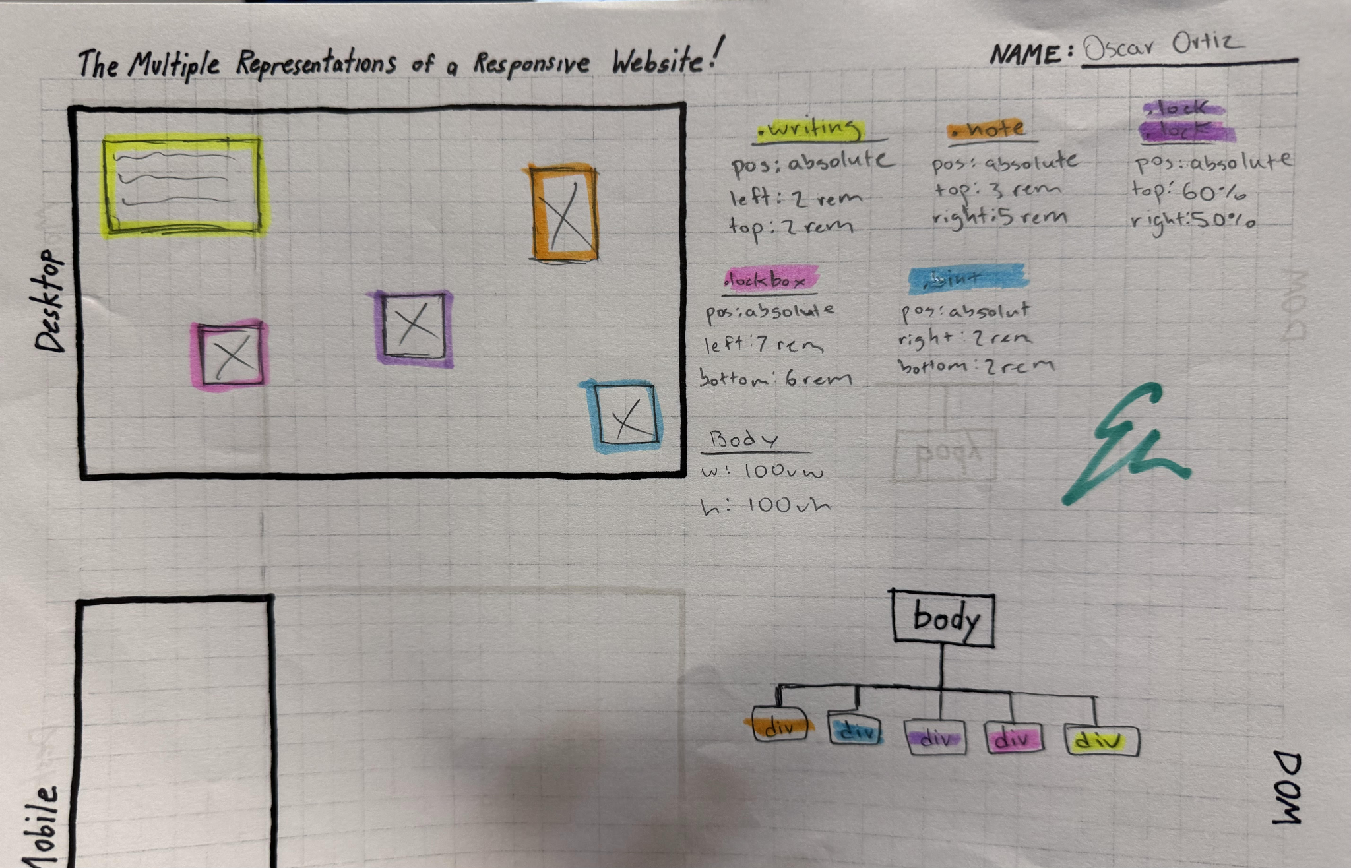

Slide 31
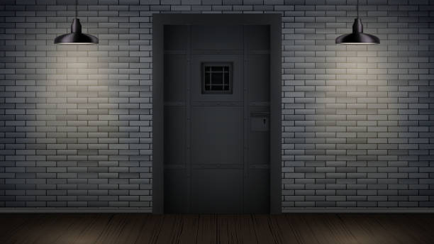


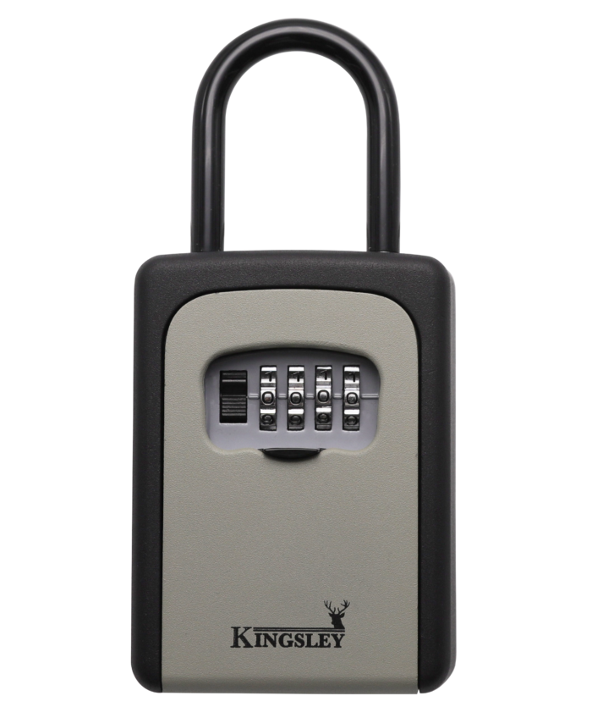

This is it, freedom! I just need to figure out a way to get passed this door.
password here
ENTER

